Slide 1
Engineering Design Process
Goal: Learn to use the engineering design process as a guide through any STEM activity.
Training Process: We’re using a sample activity (TouchDown) and will go through each step of the EDP and suggest ways you can:
Prepare to lead the activity
Explore implementation strategies
Your job: Think about how you guide students through the TouchDown activity using the EDP and jot down your ideas and reflections.

Slide 2
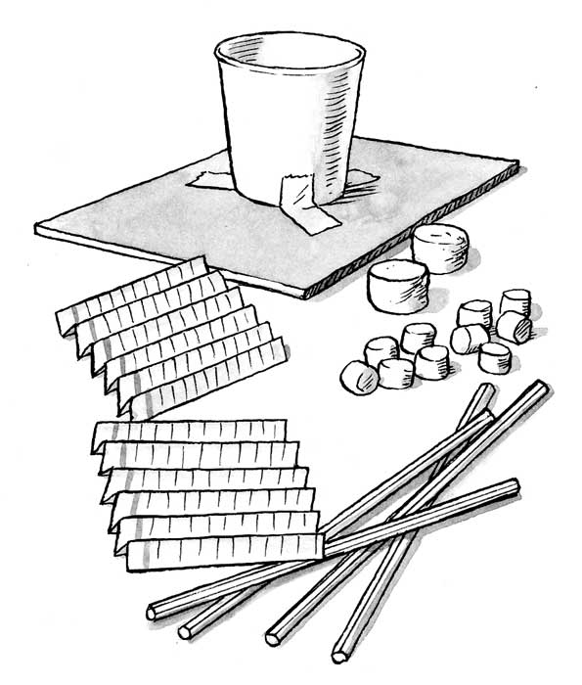
Review Sample Activity: Touchdown
The Challenge
Design and build a system that will protect two “astronauts”
when they land.
The Specs
The lander should not tip over on impact and astronauts
can not be ‘trapped’.
Materials
4x5 cardboard or stiff paper
Small paper/plastic cup
3 index cards
2 regular marshmallows (aka the astronauts)
10 mini marshmallows
3 rubber bands
8 straws
Tape

Slide 3
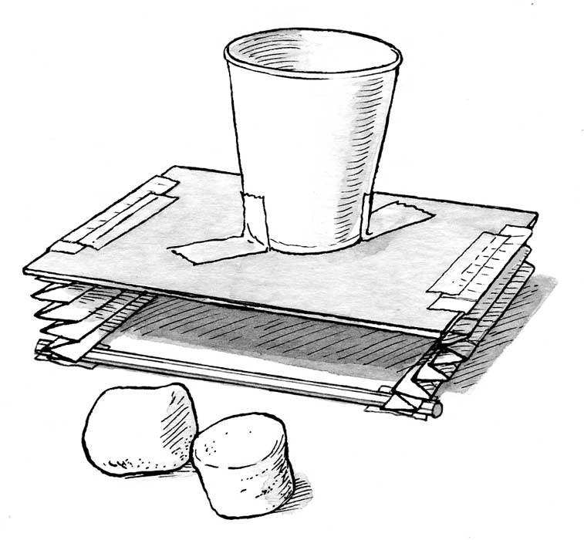
Review Sample Activity: Touchdown
Brainstorm
How can you help it land upright?
What materials will help cushion the landing?
Build
Build shock-absorbers that will protect the “astronauts”
upon impact.
Test & Redesign
Use it repeatedly.
What changes can you make?
What can you learn from others?

Slide 4
Step 1: Identify the Problem
Getting Ready: BEFORE you meet with students:
Do the activity! This helps you anticipate where kids might need assistance, and you’ll be prepared to respond to questions that come up.
Identify the activity’s learning goal.
What connections to real-world engineering can you make?
Does this activity offer an opportunity to share the engineering messages of making a difference, creativity, or teamwork?
How might you introduce the activity?
Notes:
.

Slide 5
Step 1: Identify the Problem
Examples from Touchdown
How would you introduce TouchDown?
What problem(s) needs to be solved to make a successful lander?
Examples: How will their lander absorb the energy of impact? How will they make sure their lander doesn’t tip over? How will they make sure the astronauts don’t fall out in mid-flight without ‘trapping’ their astronauts.
Engineering Messages: Who benefits from building a successful lander? Where might they need to think creatively?
Example: Tell kids why a space craft that can land gently is important for getting astronauts to and from the moon safely.

Slide 6
Step 2: Learn the Specs
Getting Ready: BEFORE you meet with students:
Identify and decide if you want to adapt any of the requirements, constraints, and/or materials.
Decide how you’ll test their designs and what makes a successful lander.
How can you ensure that the students understand the challenge?
Example: Ask them to describe the challenge in their own words. Provide multiple activity instructions formats (written, video instructions, etc)
Think about extension ideas for the activity as teams will work through the challenge at different speeds.

Slide 7
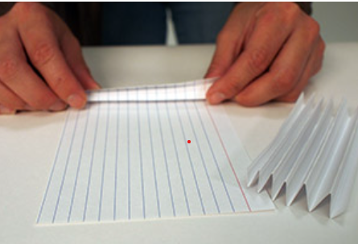
Step 2: Learn the Specs
Examples from Touchdown
Introduce the available materials and the testing criteria.
Example: When testing landers will be dropped 1 foot from the surface.
Ask the students to think about how the materials can be used to solve the problem of absorbing the impact and keep the lander from tipping over.
Example: How do springs absorb energy? Do they have any materials they can use to make a spring? How might an index card help?

Slide 8
Step 3: Brainstorm
Getting Ready: BEFORE you meet with students:
Lots of kids (and adults) like to skip this stage. Think about how can you encourage a high-energy, free-flow of ideas?
What strategies can you try if kids argue or criticize each other?
How can you get everyone to participate?

Slide 9
Step 3: BRAINSTORM
Examples from Touchdown
Ask what are some different ways to design the lander.
Encourage them to write down all ideas, no matter how wild. The more ideas, the better.
Be creative and spontaneous. There are no wrong answers and lots of possible solutions
Work as a team and respect every idea. Criticism is not allowed. Everyone should participate.

Slide 10
Step 4: DESIGN
Getting Ready: BEFORE you meet with students:
How can you help kids narrow down their ideas and choose one to try and to build?
Consider how much time the students have to complete the challenge? How might this affect the design and build stage?
How can you help kids understand the value of designing before they build?

Slide 11
Step 4: DESIGN
Getting Ready: BEFORE you meet with students:
Consider how or if you want to the students to use sketches in the design stage. They are a great tool to help them:
Refine their ideas
Work out proportions or measurements
Decide how materials will be used
Make sure their ideas can be turned into a realistic plan.

Slide 12
Step 4: DESIGN
Examples from Touchdown
Before they build, they might want to test out individual pieces of their design.
Example: Are there a few different shock absorber designs they are considering? Or have do they have some different ideas about the cabin design for their astronauts and how they secure them with out trapping them?
This is a great time to share that the EDP does not necessarily move in a straight line through all of the steps. As above, they may do tests of different pieces of their design, before moving into the full build phase.

Slide 13
Steps 5 & 6: Build and Test & Test …
Getting Ready: BEFORE you meet with students:
If you haven’t already, decide how you will test the students designs. Do you want a central testing zone, or will students test at their desks or tables?
This is also a good time to think through extension ideas for the kids who finish early. Don’t let them stop. What improvements can they make?
What questions can you ask to guide students’ thinking? Resist the urge to tell kids what to do. Great questions to have at the ready are:
Why do you think this is happening?
Is it behaving like you thought?
What changes do you want to try?

Slide 14
Steps 5 & 6: Build and Test & Test …
Examples from TouchDown
Be prepared -- it’s loud, it’s messy, it’s fun, it’s educational
Ask kids to look for what’s working, what’s not working, and what could be improved.
Example: Encourage kids to look at other teams landers. Does that spark any ideas?
Extension TouchDown examples:
Increase the drop length from 1 foot to 2 feet
Have them redesign but remove a critical building material
Challenge them to try a completely new design

Slide 15
Step 7: Share Results
Getting Ready: BEFORE you meet with students:
This step often gets skipped due to time. Kids are having so much fun it’s hard to stop them. But this is an important time to ask kids:
What worked? Did they have any unexpected outcomes or results?
Ask kids to talk about their designs and their favorite features.
Review the goal of the activity, and how someone could benefit from what they’ve made.
Is there another team’s design they admired or borrowed from?
Have kids talk about how they used the design process.

Slide 16
Step 7: Share Results
Examples from TouchDown
Gather them together to display their work.
What forces effected your lander as it fell? Did it fall like you thought it would? What changes did you make after observing it’s first test flight?
What did you learn from watching other team’s test their landers?
The moon is covered in thick dust. How might this be an advantage or disadvantage?

